Slide 1
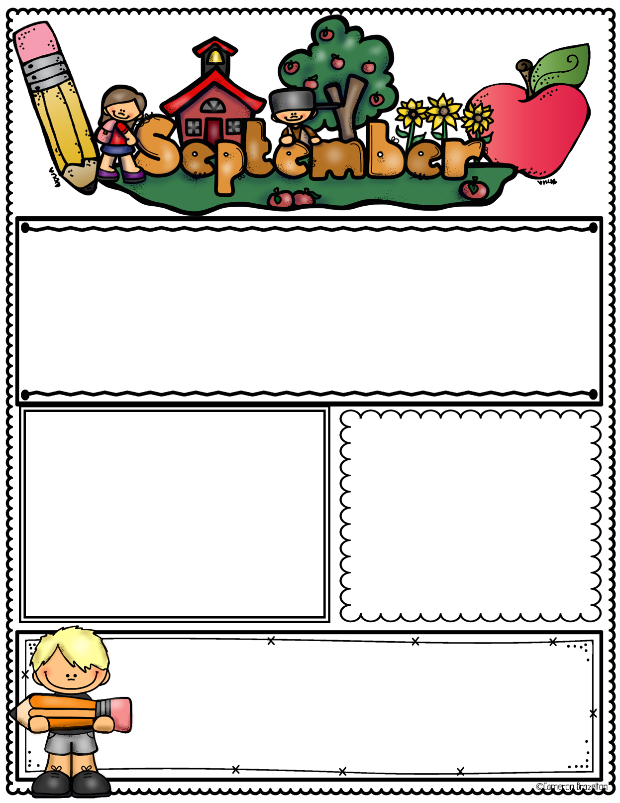
What We Are Learning
Community Helpers
Kindness/Friendship
Transportation
Farm
Important Dates
Birthdays
9/2 Labor Day
9/18 Digital Learning Day
9/24 PreK and K Picture Day
9/30-10/4 Fall Break
8/16 Yoavi
8/29 Liam P
8/30 Mrs. Story
9/12 Elias
9/14 Mrs. Aksentis
9/16 Mrs. Vance
9/21 Ian
Canes News
Book Fair at CPS 9/23-9/27
Family Night and PTC Picnic and Playground
9/24 From 4:00-6:00 PM

